Slide 1
Information Retrieval in Cloud
University of Patras
Department of Computer Engineering & Informatics
Diploma Thesis
Zois Vasileios
Α.Μ:4183

Slide 2
Presentation Contents
Distributed Systems
Hadoop Distributed File System (HDFS )
Distributed Database(HBase)
MapReduce Programming Model
Study of Β, Β+ Trees
Building Trees on ΗBase
Range Queries on B+ & B Trees
Experiments in the Construction of Trees
Analyzing Results
Conclusions

Slide 3
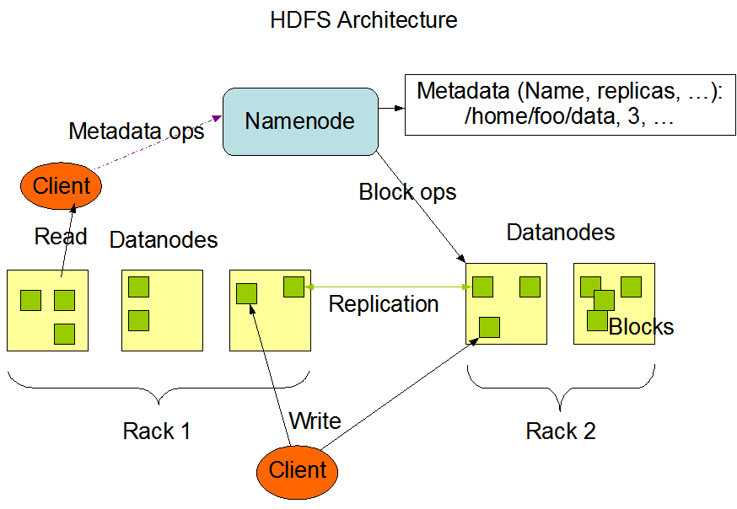
HDFS Architecture
Open Source Implementation of GFS
  Distributed File System Used by Google
  Google File System
Distributed File System
  Management of Large Amount of Data
  Failure Detection & Automatic Recovery
  Scalability
Designed Using Java
  Independent from Operating System
  Computers with Different Hardware

Slide 4
HBase Architecture
HBase
  Open Source Implementation of BigTable
  NoSQL Systems
  Organizing Data in Tables
  Tables Divided in Column Families
  Category: Column Family Stores
  Architecture Similar to HDFS
  Work Using HDFS

Slide 5
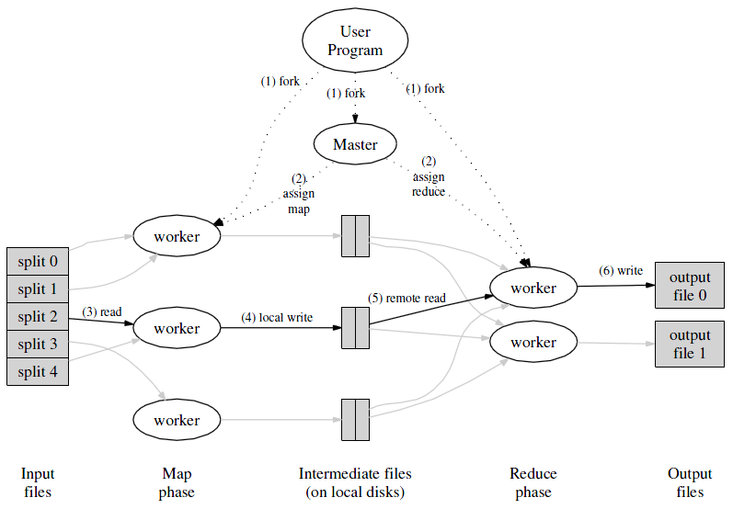
MapReduce Programming Model
Distributed Programming Model
  Data Intensive Applications
  Distributed Computing in a Cluster of Machines
Functional Programming
  Map Function
  Reduce Function
Operations
  Data Structured in (key,value)
  Process Data Parallel at Input (Mapper)
  Process Intermediate Results(Reducer)
  Map(k1,v1) → List(k2,v2)
  Reduce(k2,list(v2)) → List(v3)

Slide 6
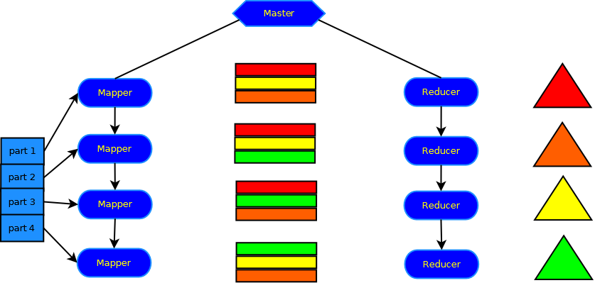
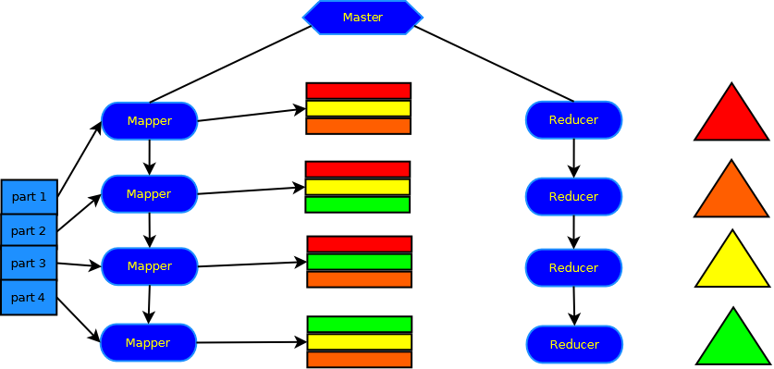
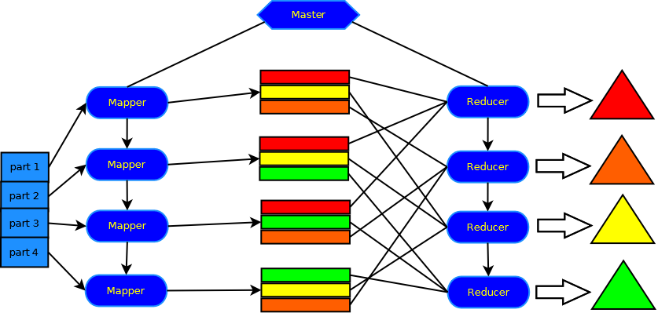
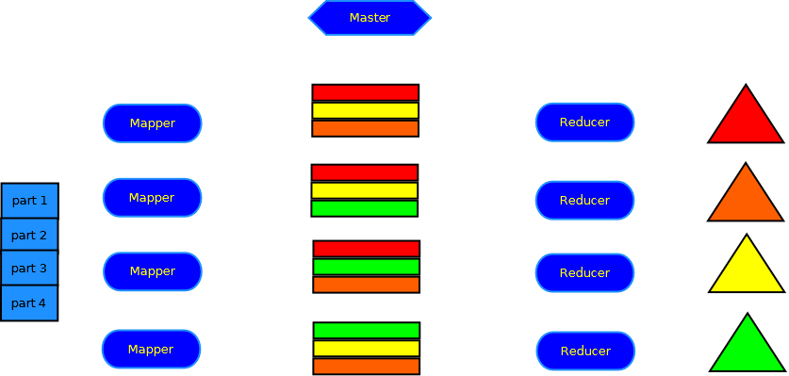


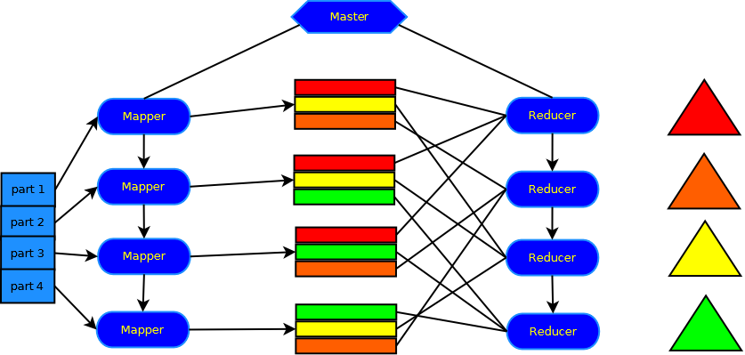
Building Tree with BulkInsert
Mapper
  Input Data Processing
  Pairing in the Form (key,value)
Custom Partitioner
  Data Clustering
  Specific Range of Values on Each Reducer
Reducer
  Tree Building(BulkInsert,BulkLoading)
  Some Data saved in memory during process
Cleanup
  Write Tree at Hbase Table

Slide 7
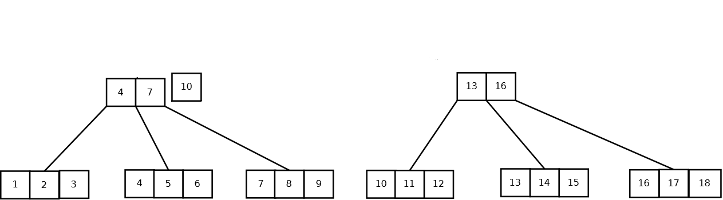
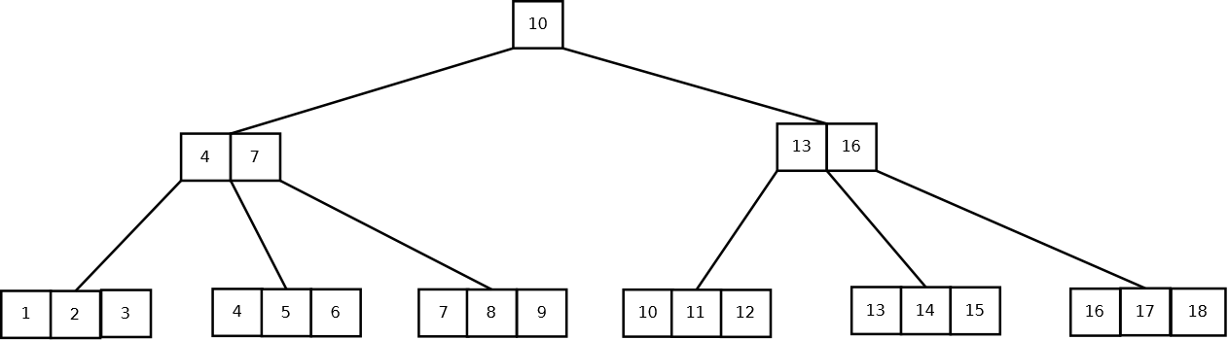
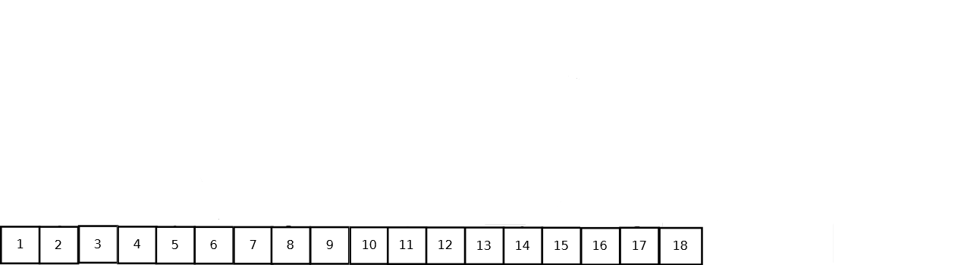
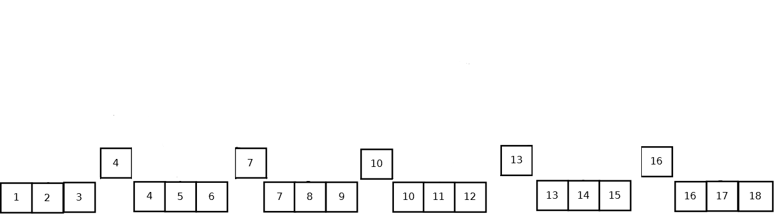
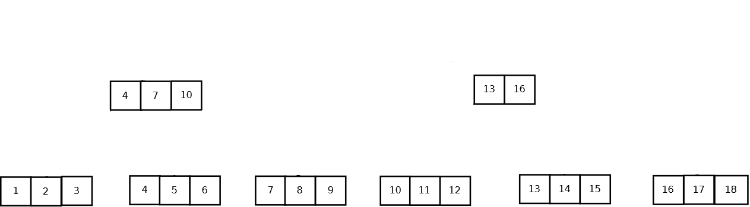
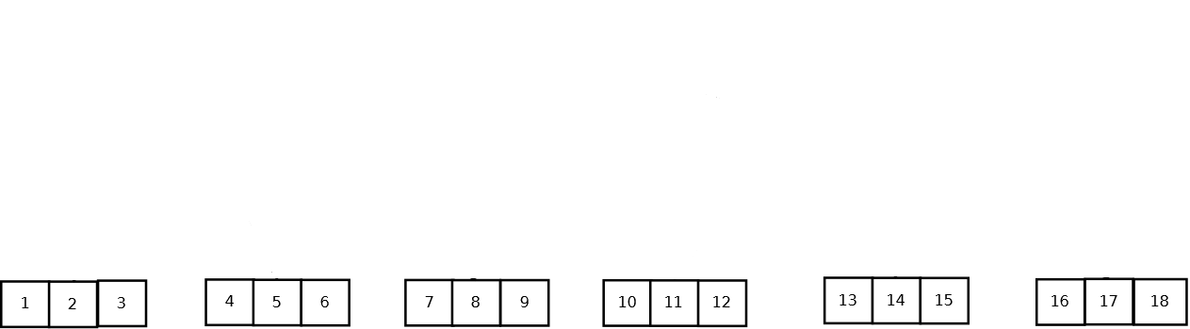
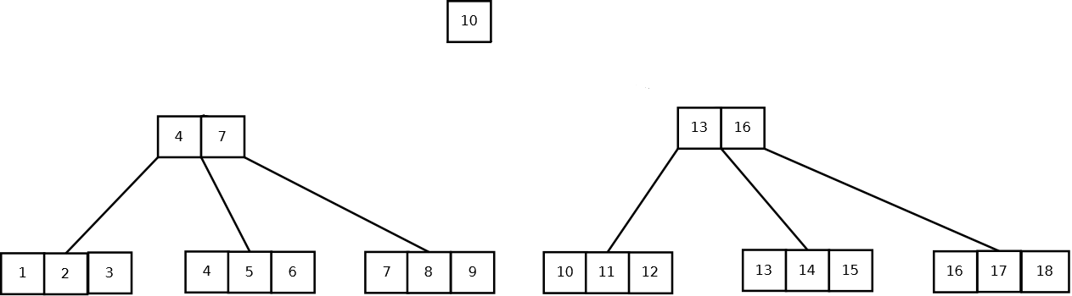
Building Tree with BulkLoading
More Efficient
  Lesser Requirements in Physical Memory.
  Completion in Less Steps Ο(n/B).
  Relative Easy Implementation
Execution Steps
  Sorted keys from Map Face
  Divide into Leafs
  Save Information for the Next Level
  Write Created Nodes when Buffer Full
  Repeat Procedure Until you Reach the Root

Slide 8
Organizing Data in Table
Tree Node = Row in Table
Define Node Column Family
Row Key
  Internal Nodes – Last Key of Respective Node
  Leafs – Adding a Special Tag in Front of Last Node key (Sorting in Lexicographic order)

Slide 9
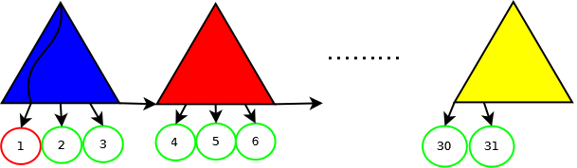


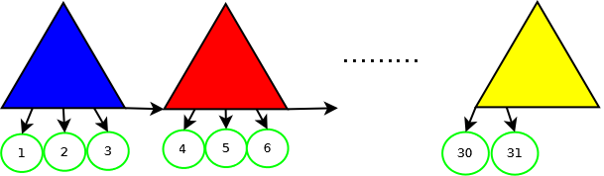
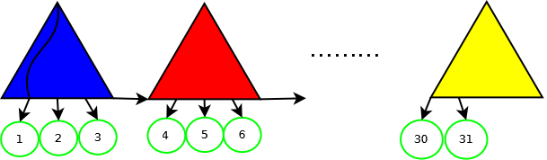
Range Queries on Β+ Trees
Check Tree Range
Find Leaf
  Leaf Including left range
  Leaf Including right range
  Hbase Table
  Scan to Find Keys
  Use Rowkey from each Leaf to Scan
Complexity
  Τ Trees , Ε keys in Tree, Β Tree Order
  Ο(2*(Τ + log_{B}(E) )

Slide 10
Range Queries on B Trees
Respectively with B+ Trees
  Find Trees with Required Range
  Pinpoint Individual Trees from Start to End
  Execution of Depth First Search on Each Tree
Depth First Search
  Retrieval of Keys in Internal Nodes
Complexity
  Depth First Search Complexity
  Ο(|V| + |E|)*Τ

Slide 11
Experiments – Systems & Tools
Hadoop & HBase
  Hadoop version 1.0.1
  HBase version 0.94.1
Operating System
  Debian Base 6.0.5
Machines(4) – Okeanos
  4 CPUs(Virtual) per machine
  RAM 2048MB per machine
  HDD 40 GB per machine
Data
  tpc-H
  Orders Table (cust_id,order_id)

Slide 12
Experiments – Data & Observations
Experiment Observation
  Tree Order
  Execution Time
  Necessary Storage Space
  Physical Memory
  Number of Reducers

Slide 13
Experiments – Bulk Insert
Comparison of Trees with Order 5 & 101
  Augmented Execution Time
    Rebalance Operation
  Physical Memory & HDD Space
    Necessary Information for Tree Structure
Conclusion
  Problem in Scalability
  Large Physical Memory Requirements
  Augmented Execution Time

Slide 14
Execution Time Distribution – Order 5

Slide 15
Execution Time Distribution – Order 101

Slide 16
Experiments – Bulk Insert
Tree Order 5 | Β+Tree | B-Tree
Data Input Size | 230ΜΒ | 230MB
Output Tree Size | 2,2 GΒ | 1,4 GB
Execution Time (sec) | 900 | 451
Median Execution Time Map(sec) | 56,29 | 55
Median Execution Time Shuffle (sec) | 28 | 28,75
Median Execution Time Reduce (sec) | 125,5 | 88,25
Number of Reducers | 8 | 8
Physical Memory Allocated | 19525 MB | 15222 MB
Tree Order 101 | Β+Tree | B-Tree
Input Data Size | 230ΜΒ | 230MB
Output Tree Size | 598,2ΜΒ | 256MB
Execution Time (sec) | 263 | 246
Median Execution Time Map (sec) | 52 | 49,86
Median Execution Time Shuffle (sec) | 28,63 | 29,75
Median Execution Time Reduce (sec) | 68,25 | 66,25
Number of Reducers | 8 | 8
Physical Memory Allocated | 9501 MB | 9286 MB

Slide 17
Experiments – Bulk Loading
BulkLoading vs BulkInsert Comparison
  Smaller Execution Time
  Less Requirements in Physical Memory
  Smaller Required Space on HDD
Testing Buffer Fluctuation
  Buffer 128,512
  Smaller Execution Time
  Adjustable Requirements for Physical Memory

Slide 18
Execution Time Distribution – Buffer 128

Slide 19
Execution Time Distribution– Buffer 512

Slide 20
Experiments – Bulk Loading
Tree Order 101 | Β+Tree | B-Tree
Input Data Size | 230ΜΒ | 230MB
Output Tree Size | 267,1ΜΒ | 256MB
Execution Time (sec) | 132 | 125
Median Execution Time Map(sec) | 51,14 | 53,57
Median Execution Time Reduce (sec) | 43,5 | 37,75
Number of Reducers | 8 | 8
Buffer Size(Put Objects) | 128 | 128
Physical Memory Allocated | 6517 ΜΒ | 6165 ΜΒ
Tree Order 101 | Β+Tree | B-Tree
Input Data Size | 230ΜΒ | 230MB
Output Tree Size | 267,1ΜΒ | 256MB
Execution Time (sec) | 114 | 108
Median Execution Time Map(sec) | 52 | 55,14
Median Execution Time Reduce (sec) | 33 | 30,63
Number of Reducers | 8 | 8
Buffer Size(Put Objects) | 512 | 512
Physical Memory Allocated | 6613 ΜΒ | 6678 ΜΒ

Slide 21
Conclusions
In Comparing Building Techniques
  BulkInsert
    Precise Choice of Tree Order
    Augmented Execution Time with Small Order Trees Due to constant Rebalancing
    High Physical Memory Requirements
    Not So Scalable
  BulkLoading
    Created Tree is Full ( Next Insert could cause an Tree Rebalancing)
    Smaller Execution Time
    Adjustable Requirements in Physical Memory
    More Complicated Implementation
Why Use B & B+ Trees
  In Collaboration with Pre-Warm Techniques
  Less Burden on Master.
  Communication Between Slaves

Slide 22
THANK YOU FOR YOUR ATTENTION!!!

